Slide 1

Exploring Micromobility and Factors in Growth and Success of the Programs

Slide 2
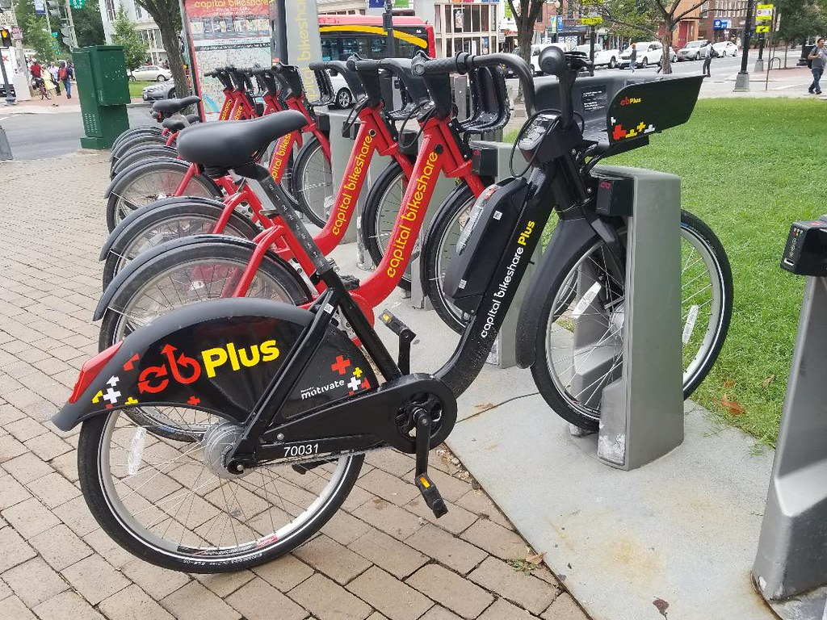
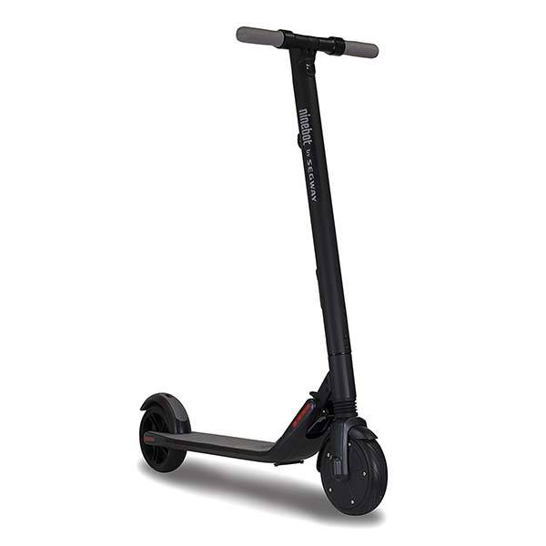
What is Micromobility?
Shared-use simple methods of transportation, including bikeshare and scooter programs
Help combat traffic congestion and pollution in cities
Global micromobility market projected to grow from $44 billion in 2020 to over $214 billion by 2030
Large cities have implemented micromobility programs (New York, Chicago, San Francisco)
This Photo by Unknown Author is licensed under CC BY-NC
This Photo by Unknown Author is licensed under CC BY-SA-NC

Slide 3
Data Overview and Elements
Unit of Analysis is at the city level
Each row represents one trip from point A to point B
Each city can have millions of trips per year
Not all city programs track the same data elements
Data from other sources to be used in conjunction for analysis (city unemployment, demographics)
Standard Data Fields
Date/Time of Departure
Departure Station
Date/Time of Arrival at Destination
Destination Station
Type of Transport (docked/undocked bike, e-bike)
Type of Customer (daily, monthly pass)
Extra Data Fields (not always present)
Departure Geocoordinates
Destination Geocoordinates
Gender
Year of Birth

Slide 4
Data Derived Elements
Derived fields created to provide additional features for use in analysis
Derived Data Fields
Duration of Trip
Hour of Day
Month
Year

Slide 5
Research Questions
What factors impact usage and growth of micromobility?
Can machine-learning be used to accurately:
Predict growth or usage patterns in micromobility?
Identify other cities where micromobility programs would have a high likelihood of success?
Notes:
1) Economic/socio-economic? Demographics? Geographic location?

Slide 6
Research Process
Obtain and Clean
Obtain and Clean Micromobility Data for Multiple Cities
Perform EDA
Perform Exploratory Data Analysis
Identify Features
Identify Key Features
Apply ML
Train and test machine learning models to predict usage and growth
Evaluate and Conclude
Evaluate accuracy and develop conclusions
Notes:
Throughout, this also includes obtaining the other supplemental datasets for demographics, etc.
Cleansing the data has been particularly time consuming as not only do different cities track different fields, the individual cities also have tracked different data elements over the past 3 years of review. This has been time consuming going through the files to then determine how to merge the data in ways to allow for mostly consistent reviews over the full time period.

Slide 7
Data Cleansing Challenges
Merging data from different time periods
Field layout changes within each city over time
Cities track different field elements
Significant number of nulls impact usefulness
Sheer volume of data
Notes:
This has been particularly time consuming in working with this particular disparate data

Slide 8
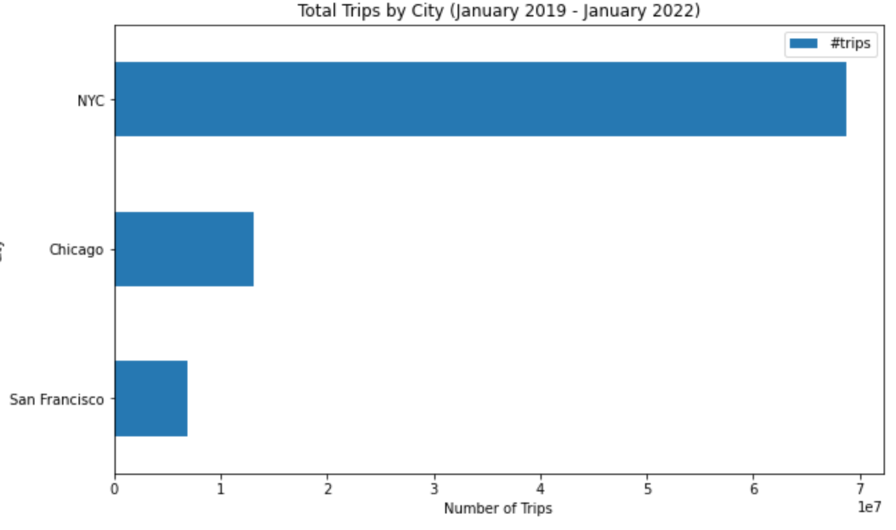
EDA – By City for January 2019 through January 2022
Included three cities in our analysis
NYC had nearly 70 million trips
Chicago totaled 13 million trips
San Francisco had about 7 million trips

Slide 9
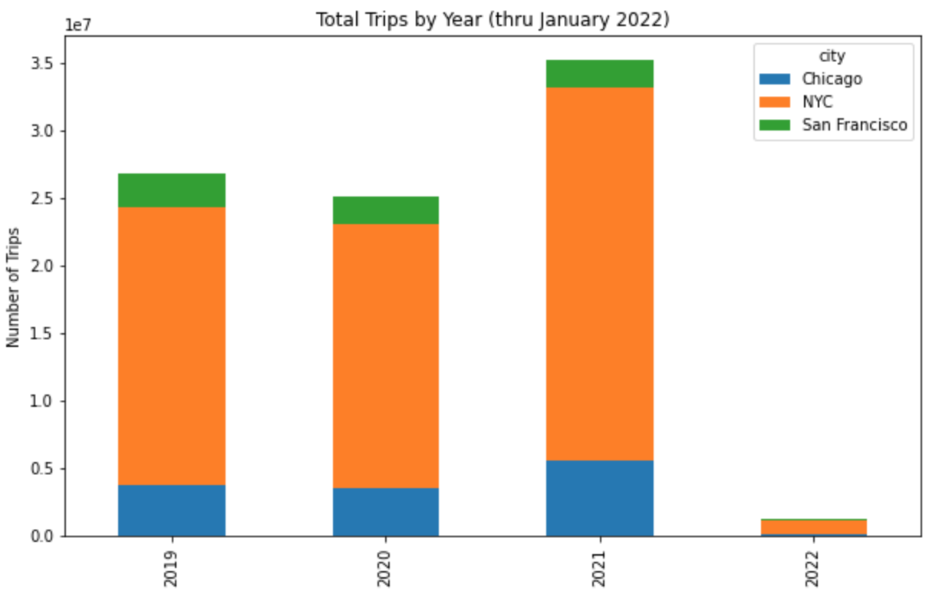
Summary of Trips by Year
Decrease in usage in 2020 with the Covid-19 pandemic
2021 trips in total exceeded that of 2019 before the pandemic
San Francisco’s usage remained relatively steady

Slide 10
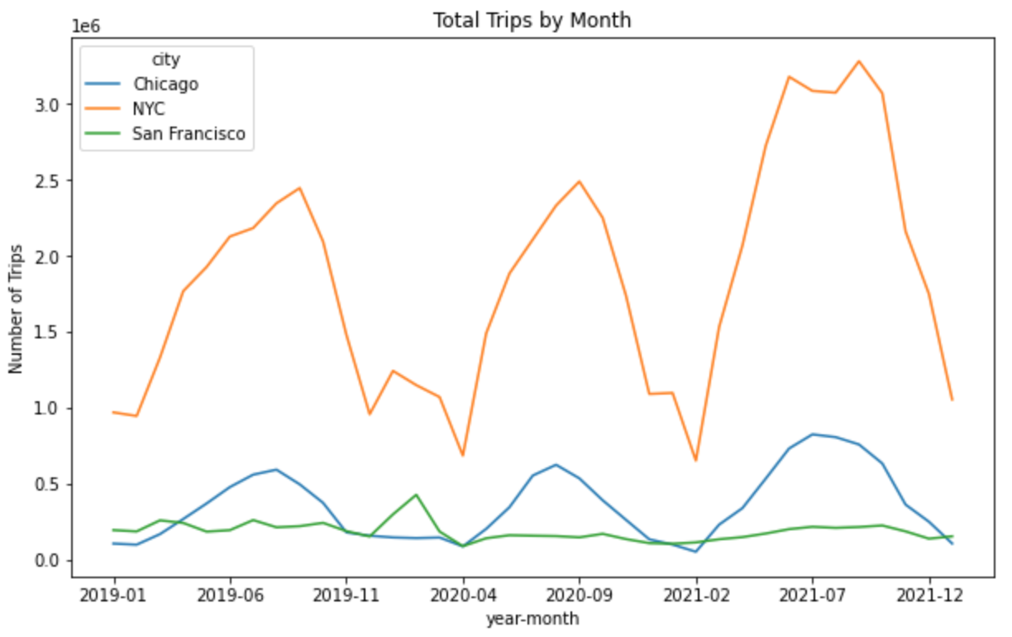
Seasonal Patterns in Usage
Usage is clearly seasonal for NYC and Chicago
San Francisco is relatively consistent throughout the seasons
Chicago’s usage most consistent over the three year period
Usage in NYC has skyrocketed in 2021

Slide 11
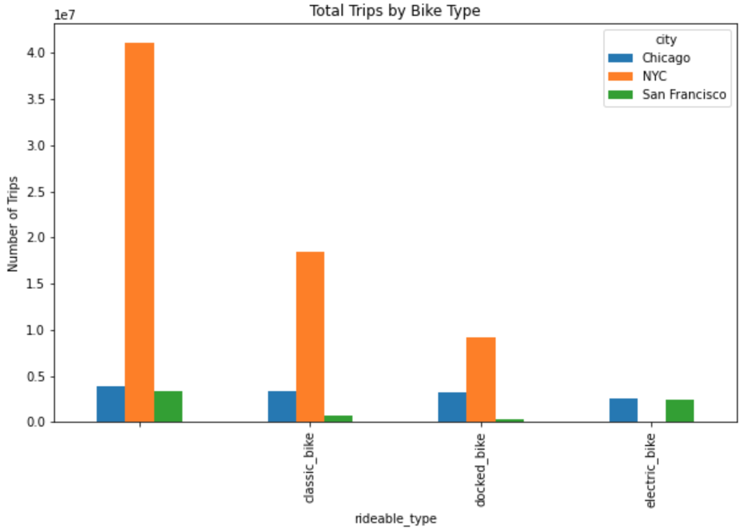
Types of Bikes
Large number have no type specified
E-Bike usage minimal in NYC but significant in San Francisco
Classic dockless bikes are predominant in NYC

Slide 12
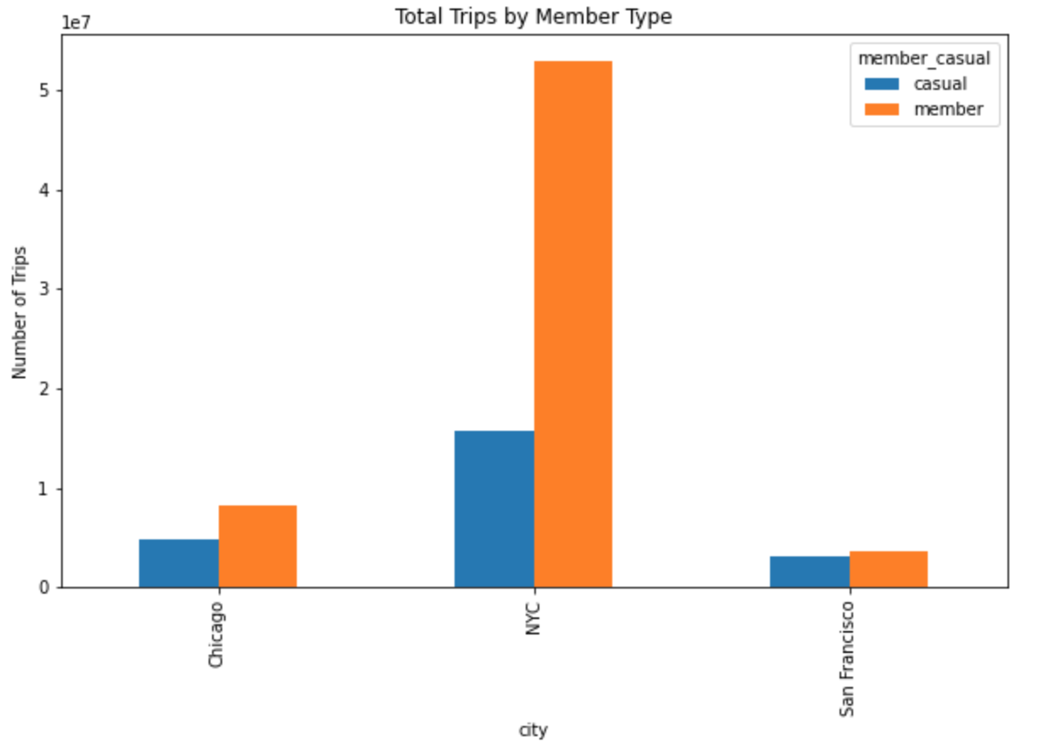
Types of Users
All three cities have more trips by members than casual riders
NYC’s usage by members far exceed casual riders
San Francisco is nearly even between members and casual riders

Slide 13

Machine Learning Models
ARIMA – Provides unique benefits for forecasting based on time series data, such as to forecast inflation in Ireland.
Long Short-Term Memory (LSTM) Neural Network – Found to be suitable for time series based forecasting with multivariate input.
K-Nearest Neighbor (KNN) –Research has been performed on the use of KNN for things like forecasting GDP growth.
Random Forest –Beneficial with large datasets with many attributes.
Naïve Bayes – Widely used for prediction.
Least Squares Support Vector Machine (LS-SVM) – Found to be useful in various forecasting applications, including traffic forecasting.

Slide 14
Machine Learning - ARIMA
AutoRegressive Integrated Moving Average (ARIMA) is a univariate analysis useful for prediction when using time series data.
Seasonal ARIMA (SARIMA) is an extension of ARIMA that accounts for time series data that contain a seasonal element. From EDA, it appears there is a seasonal component to micromobility usage for NYC and Chicago.
Notes:
Through the EDA, it appears that micromobility generally follows a seasonal pattern but we will look closer at that.

Slide 15
SARIMA Methodology
We will use SARIMA to predict usage for NYC and Chicago in terms of number of trips (our Target Variable)
We will need to determine the below 7 elements to build our model
Elements of SARIMA
SARIMA(p,d,q)(P,D,Q)m
p: Trend autoregression order. d: Trend difference order. q: Trend moving average order. | P: Seasonal autoregressive order. D: Seasonal difference order. Q: Seasonal moving average order. m: The number of time steps for a single seasonal period.
Notes:
Through the EDA, it appears that micromobility generally follows a seasonal pattern but we will look closer at that.

Slide 16
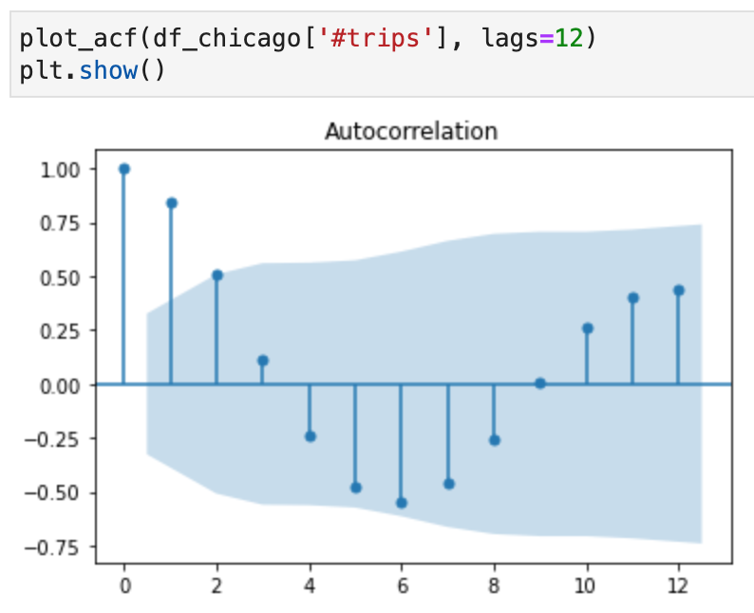
SARIMA – Determine Parameter Value ‘p’
SARIMA(p,d,q)(P,D,Q)m
Parameter ‘p’: The ACF plot is used, and it shows the autocorrelations measuring the relationship between an observation and its previous one.
p will be 2 as it is the maximum lag with a value in the ACF plot external to the confidence interval shaded in blue.

Slide 17
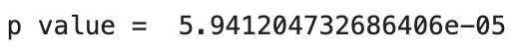
SARIMA – Determine Parameter Value ‘d’
SARIMA(2,d,q)(P,D,Q)m
Parameter ‘d’: The Dickey-Fuller test is used to test for Stationarity of the dataset. For stationarity, the p value returned by the Dickey-Fuller test must be <= 0.05.
d will be 0 as the data is stationary without the need for any transformations. The p value was

Slide 18
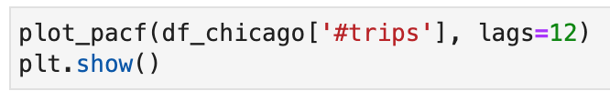
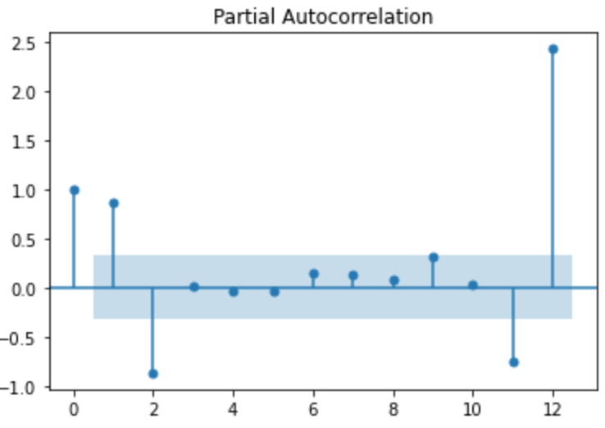
SARIMA – Determine Parameter Value ‘q’ and ‘m’
SARIMA(2,0,q)(P,D,Q)m
Parameter ‘q’: The PACF plot is used to determine the value for q.
q will be 12 as it the maximum lag with a value in the PACF plot external to the confidence interval shaded in blue.
m = 12 as the seasonality is annual (12 months)

Slide 19
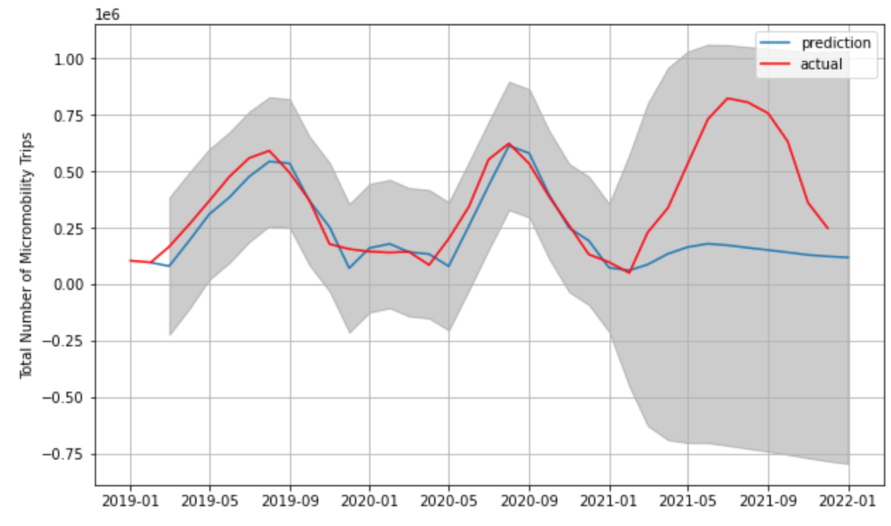
SARIMA – Results for Chicago
SARIMA(2,0,12)(P,D,Q)12
Using the SARIMAX Python library, we use the parameters. Note that the library determines the P, D, and Q.
Trained the model on the first 24 months of data. Prediction is the last 12 months (starting January 2021).
As shown, the prediction was not accurate.
Expanding to more years in order to provide more data to train the model.

Slide 20
Machine Learning Models – Additional Work in Progress
Expanding the time period of the micromobility data to use with ARIMA to improve the accuracy of the model, and evaluating the results for the other cities beyond Chicago (NYC and San Francisco).
Trying to predict based on total/avg duration of trips and contrast/compare that to the predictions based on # of Trips. Does one perform better than the other?
Consolidating the results here in the slides comparing the results and accuracy for each citys.
Applying the LSTM Neural Network model to perform multivariate prediction and determine how its performance compares to ARIMA and how different features impact the accuracy of the model.
Notes:
Through the EDA, it appears that micromobility generally follows a seasonal pattern but we will look closer at that.

Slide 21
Expected Results & Outcomes
Better understand usage patterns of micromobility and factors most relevant to predict usage, growth, and the success of programs.
Gain insights for evaluating and identifying other cities where micromobility programs would be successful.

Slide 22
References
Market background: https://www.alliedmarketresearch.com/micro-mobility-market-A11372#:~:text=The%20global%20micromobility%20market%20was,17.4%25%20from%202021%20to%202030
New York City Data: https://ride.citibikenyc.com/system-data
J. Du, Q. Liu, K. Chen and J. Wang, "Forecasting stock prices in two ways based on LSTM neural network," 2019 IEEE 3rd Information Technology, Networking, Electronic and Automation Control Conference (ITNEC), 2019, pp. 1083-1086, doi: 10.1109/ITNEC.2019.8729026.
Jönsson, Kristian. "Machine learning and nowcasts of Swedish GDP." Journal of Business Cycle Research 16.2 (2020): 123-134.
I. Kumar, K. Dogra, C. Utreja and P. Yadav, "A Comparative Study of Supervised Machine Learning Algorithms for Stock Market Trend Prediction," 2018 Second International Conference on Inventive Communication and Computational Technologies (ICICCT), 2018, pp. 1003-1007, doi: 10.1109/ICICCT.2018.8473214.
Meyler, Aidan, Geoff Kenny, and Terry Quinn. "Forecasting Irish inflation using ARIMA models." (1998): 1-48.
Zhang, Yang, and Yuncai Liu. "Traffic forecasting using least squares support vector machines." Transportmetrica 5.3 (2009): 193-213.
https://towardsdatascience.com/understanding-the-seasonal-order-of-the-sarima-model-ebef613e40fa

Slide 23
Thank You

